Slide 1
The SAM Pattern A Distributed System View of Front-End Architectures
J.J. DUBRAY
xgen.io

Slide 2
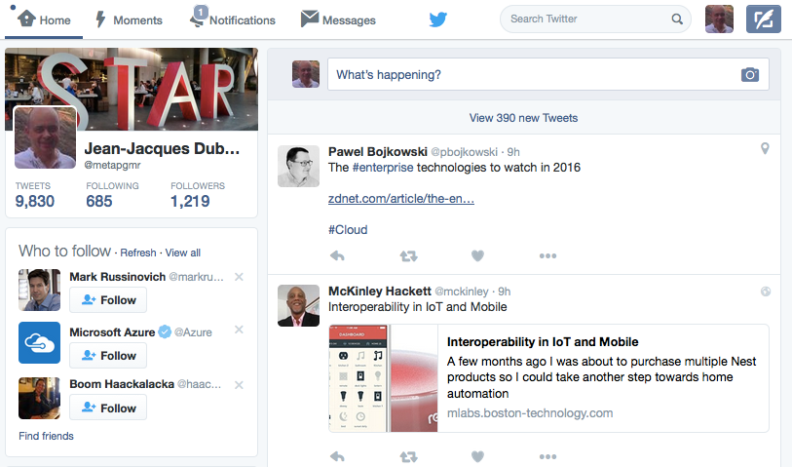
Modern GUIs have become just a Node in a Dynamic Distributed System
your friends,
players
your watch
IoT sensors
…
© 2016 xgen.io
Notes:
Graphical User Interfaces are part of a wide class of software, Reactive Applications, that responds to user input, network messages, and other events
Reactive code is asynchronously triggered by event occurrences
It is hard to trace and understand the control flow of the entire system

Slide 3
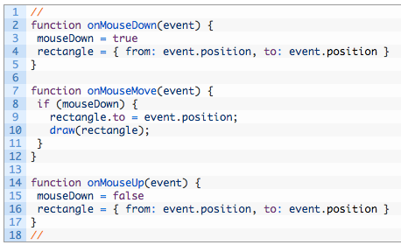
Events and Callbacks
Composability
Encapsulation
Subscriptions
Separation of Concern
Data Consistency
Maintainability
…
from
to
© 2016 xgen.io
Ingo Mayer et al (https://infoscience.epfl.ch/record/176887/files/DeprecatingObservers2012.pdf)

Slide 4
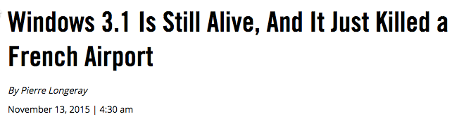

Slide 5
© 2016 xgen.io

Slide 6
The GUI and the Back-End API
© 2016 xgen.io

Slide 7

The Devs and the Architect
© 2016 xgen.io

Slide 8
Redux
© 2016 xgen.io

Slide 9
Angular2

Slide 10
SCRUM
CONSTRUCTION HAD TO BE STARTED OR BUILDER WOULD BE FINED
Source: http://www.bangkokpost.com/learning/advanced/1009037/footbridge-with-powerpole-through-it-fixed

Slide 11
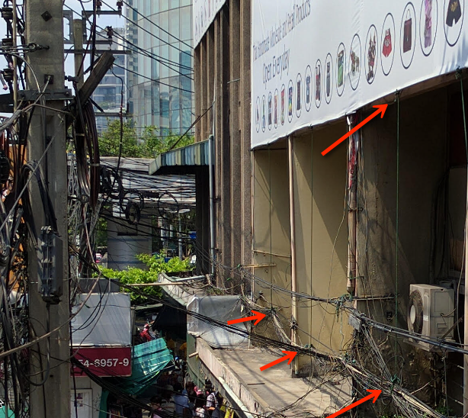
Code Reuse
© 2016 xgen.io

Slide 12
AWS Outage
22-wheel truck
downs 47 power poles
Source: http://www.bangkokpost.com/learning/learning-from-news/641220/22-wheel-truck-downs-47-power-poles-18-wheeler-drags-12-year-old-to-death

Slide 13
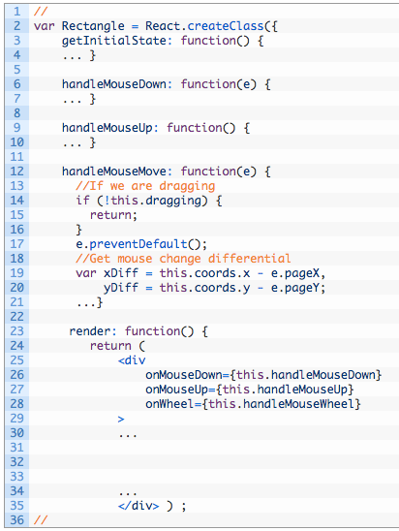
After some intense research …
Leading Web Frameworks like React and Angular came up with component Model by
simply putting a box around the code we used to write
add a change detection mechanism to re-render components automatically each time their properties change

Slide 14
Introducing
Functional Reactive Programming

Slide 15
Functional Reactive Programming
The main idea of FRP is to build programs in a declarative only way, by defining [event] streams, how they are linked together and what happens if a new stream value arrives over time.
Source: http://blog.jhades.org/functional-reactive-programming-for-angular-2-developers-rxjs-and-observables/
Jennifer Paykin http://www.cis.upenn.edu/~jpaykin/papers/pkz_LTTT.pdf
© 2016 xgen.io

Slide 16
… BUT
FRP programs are purely functional
which alleviates the problems of synchronizing state with behavior
[They] can be built with very little to no application state variables, which are in general a source of errors.
To make it clearer: the application does have state, but that state its typically stored on certain streams or in the DOM, not on the application code itself.
Source: http://blog.jhades.org/functional-reactive-programming-for-angular-2-developers-rxjs-and-observables/
© 2016 xgen.io
Jennifer Paykin http://www.cis.upenn.edu/~jpaykin/papers/pkz_LTTT.pdf

Slide 17
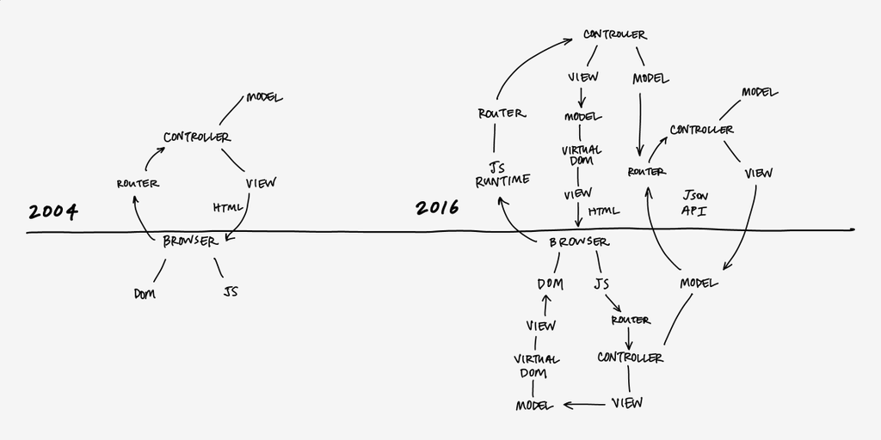
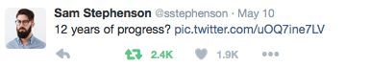
Source: https://twitter.com/sstephenson/status/730039913052176384
© 2016 xgen.io

Slide 18
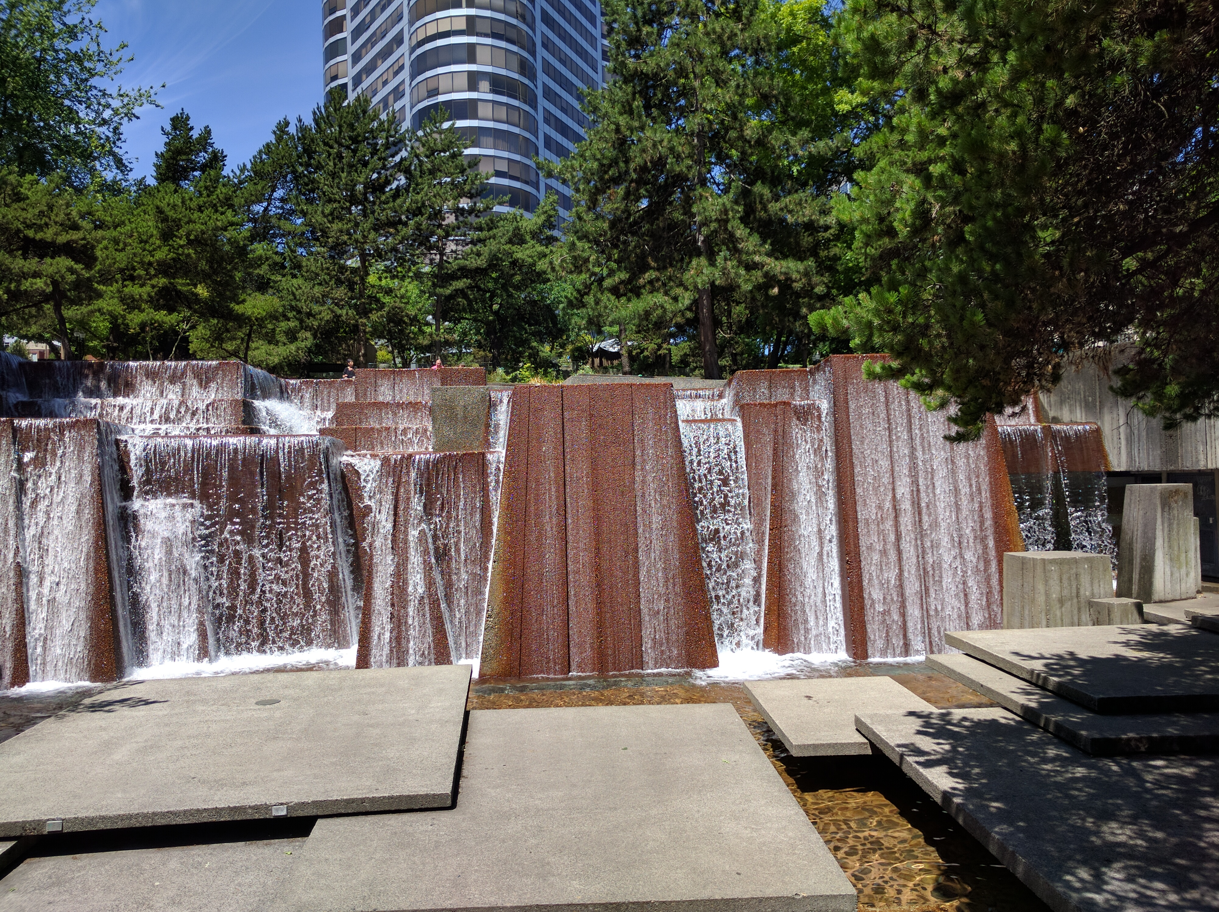
Semantics Matter
Source: Lee Byron, Immutable User Interfaces
https://vimeo.com/album/3953264/video/166790294
© 2016 xgen.io

Slide 19
Angular2
reactive()
Component
Template
Event
Component
Template
Event
Component
Template
Component
Template
© 2016 xgen.io

Slide 20
MobX
reactive()
functional()
Observable
Action
(Mutation)
Computable
Reaction
Observable
Observable
Computable
Action
(Mutation)
Observable
Computable
Reaction
Observable
© 2016 xgen.io

Slide 21
React/Redux
functional()
reactive()
Action
(Intent)
Reducer
(Action + Mutation)
Store
View
Action (Intent)
Thunks
Sagas
…
© 2016 xgen.io

Slide 22
Elm
functional()
reactive()
Update (Mutation)
Subscription
View
Subscription
Command
(Action)
Task
Task
Task
© 2016 xgen.io
Source: https://www.gitbook.com/book/sporto/elm-tutorial/details

Slide 23
Cycle.js
reactive()
functional()
View$
Intent$
Model$
Intent$
Driver
Driver
Intent$
© 2016 xgen.io

Slide 24
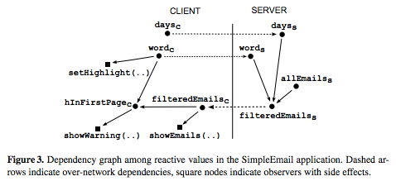
Over-Network Reactive Dependency Graphs
Source: G. Salvaneschi et al
http://www.guidosalvaneschi.com/attachments/papers/2013_Towards-Distributed-Reactive-Programming_pdf.pdf
© 2016 xgen.io

Slide 25
Introducing SAM
- State-Action-Model -

Slide 26
The SAM Pattern
View
V = f(M)
??
Model
© 2016 xgen.io

Slide 27
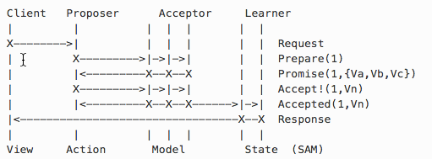
The Paxos Protocol
Consensus based protocol to achieve data consistency
in distributed systems?
Source: Mark Chu-Carroll
http://www.goodmath.org/blog/2015/01/30/paxos-a-really-beautiful-protocol-for-distributed-consensus/
https://en.wikipedia.org/wiki/Paxos_(computer_science)
© 2016 xgen.io

Slide 28
The SAM Pattern
View
1
Proposers
var p_counter = counter + 1 counter.accept(p_counter)
var p_counter = counter + 1 counter = p_counter
var p_counter = counter + 1 counter.accept(p_counter).then(learn)
Counter = Counter + 1
V = f(M)
Counter = Counter + 1
2
Acceptor(s)
3
Learners
Model
Dr. Leslie Lamport: TLA+
http://research.microsoft.com/en-us/um/people/lamport/pubs/state-machine.pdf
© 2016 xgen.io

Slide 29
The SAM Pattern is Unapologetically Focused on Mutation
View
V = f(Model)
1
Proposers
State
next-action(Model)
Actions
Learner(s)
3
Model
2
Acceptor(s)
© 2016 xgen.io

Slide 30
State-Action-Model
Component
Component
View
event
V = f(Model)
Action
Action
Action
Action
State
State
State
next-action(Model)
Unit of Work
Unit of Work
Model
Unit of Work
proposal

Slide 31
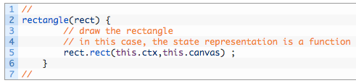
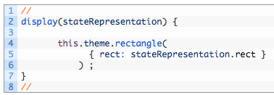
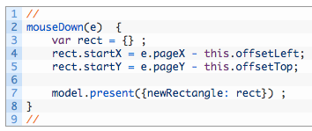
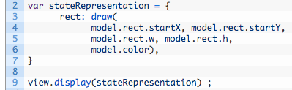
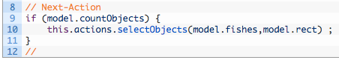
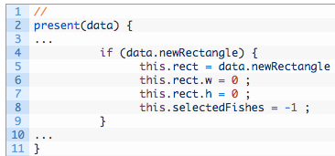
State-Action-Model
View
V = f(Model)
event
State
Action
next-action(Model)
Unit of Work
Model
proposal

Slide 32
Programming languages provide no well-defined notion of a program step
Dr. Leslie Lamport
http://research.microsoft.com/en-US/um/people/Lamport/pubs/pluscal.pdf
© 2016 xgen.io

Slide 33
SAM Pattern
View
Allowed
actions
V = f(M)
State
Actions
Allowed
proposals
Model
Step

Slide 34
Unidirectional / Single State Tree Data Flow
V = f(M)
Model
State
nap(M)
Actions

Slide 35
SAM Isolates APIs from the View
V = f(M)
CUD
Model
State
nap(M)
R
Actions
There is no need for
an immutable model (Redux)
declarative effects (Elm, ~Redux)
They create more problems than they solve

Slide 36
Why SAM?
SAM is founded on “Functional UI/HTML”
View Components are Stateless
View Components are 100% decoupled from the business logic and written outside the framework in vanilla.js/ts
Any element of the pattern can be migrated to the server (Universal JavaScript)
API calls are 100% isolated from the View
V = f(M)

Slide 37
Let’s look at some code

Slide 38
Conclusion
Programming model
Centered on Mutation, not immutability
True Single State Tree, no Sagas/Stateful components
Focused on ”what’s allowed”, not subscriptions
View Components are 100% decoupled from the application business logic
Functional UI/HTML (code generation), not templates
Architecture
Side-effects friendly
Wiring agnostic
Truly Isomorphic
Action “Hang back” / Generic Cancellations
3rd party Actions (OAuth)

Slide 39
Questions?
http://sam.js.org/
https://gitter.im/jdubray/sam

